Slide 1

Recommendation System for creating Custom Playlist
Tejasva Tomar(tt425)
Siddharth Sundararajan(ss3177)
Dev Shah (ds1560)

Slide 2
Project goal
Our aim is to build a user-interface on a recommendation engine, which suggests a playlist of songs to the user given a set of input playlists.
The user inputs three playlists, each containing ten songs.
The output is a recommended playlist of top ten songs that are similar to the songs present in the three playlists.
The input and output are seen on a user interface that is build on top of the recommendation system.

Slide 3

Outline of the Project
Description of the Project
User Interface
Project Stumbling Blocks
Data Collection
Flow Diagram
Sample Findings
Future Extensions
Acknowledgements

Slide 4
Description of the Project
Recommendation systems arise in a variety of areas such as songs, movies, games, news, books, social tags, etc.
A recommendation system is defined as an application that predicts the preference or importance a user would give to an item, or identifies a set of N items that would interest the user.
Our aim is to build a user-interface on a recommendation engine, which suggests a playlist of songs to the user given a set of input playlists. The project is divided into three main phases - Data preprocessing, Feature extraction and selection, Model building, and building an user interface.

Slide 5
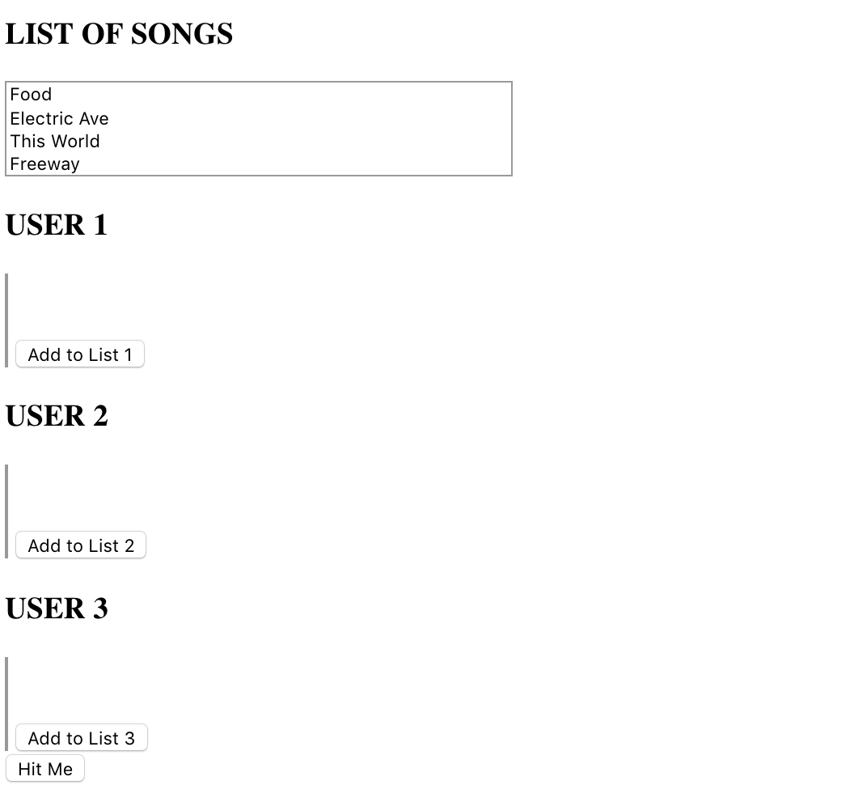
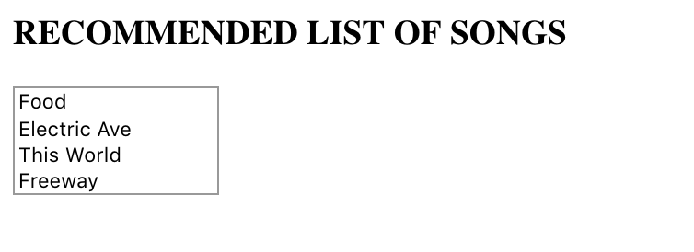
User Interface
Output View
User Input View

Slide 6
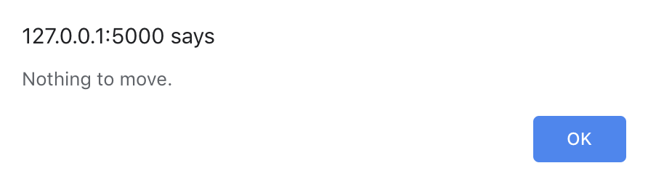
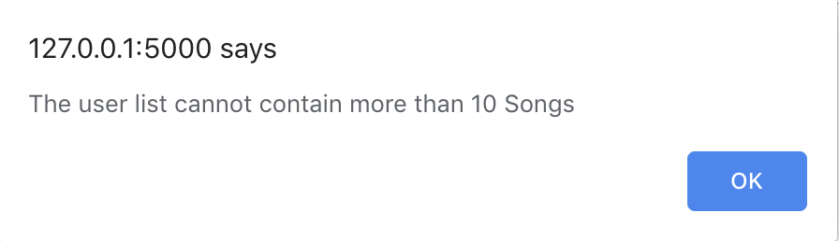
User Interface
Error messages displayed to the user

Slide 7

Project Stumbling Blocks
Selecting the right dataset with enough variables to create the model
1
Pre-processing of the data involved cleaning and type conversions
2
Retrieving the right columns from the dataset available and using them as features for model building
3
Finding the optimal value of K in the K-means Clustering and building models in K-means and K-NN
4
Working with Flask Web Framework
5

Slide 8
Data Collection
Data Source: https://github.com/mdeff/fma
Description : The dataset contains data of 106K songs with four main tables i.e. tracks, genres, features, ecohonest.
The tables were joined together to make a single data frame, out of which 11 relevant features were selected and used
Continuous data was normalized and, categorical and datetime data were converted to numerical data

Slide 9
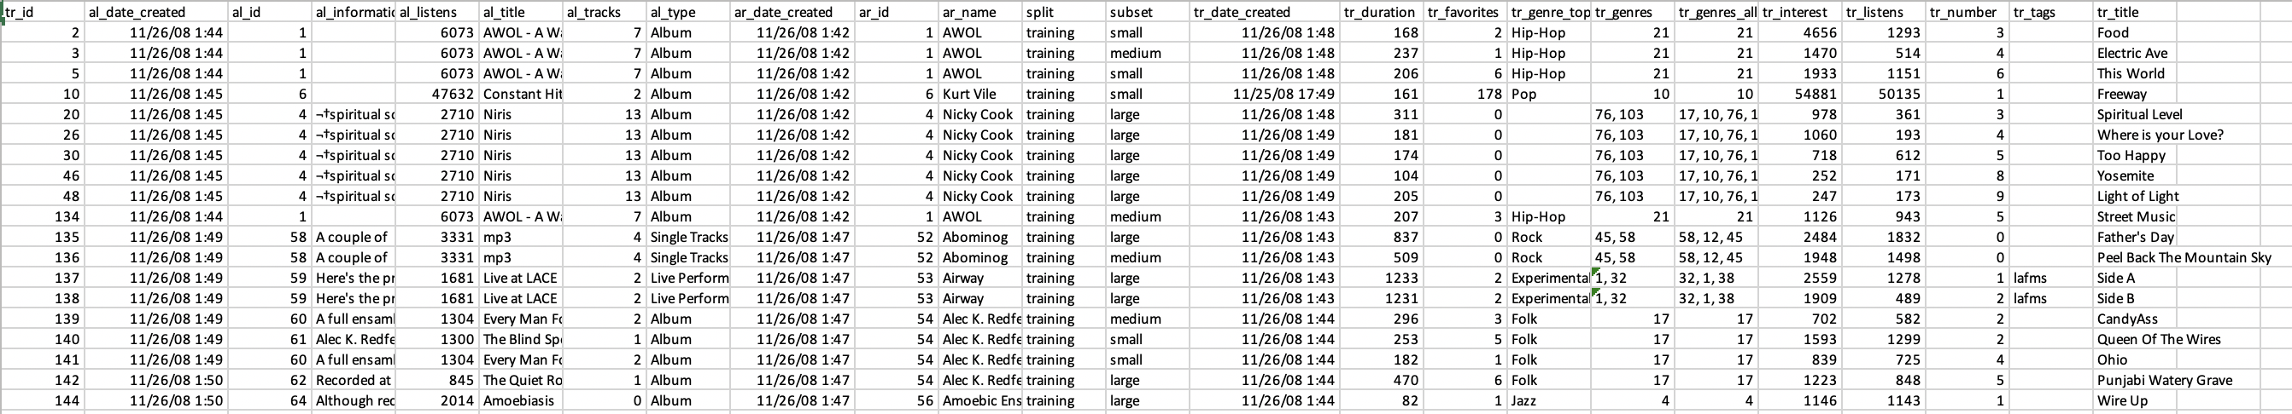
Sample Dataset

Slide 10
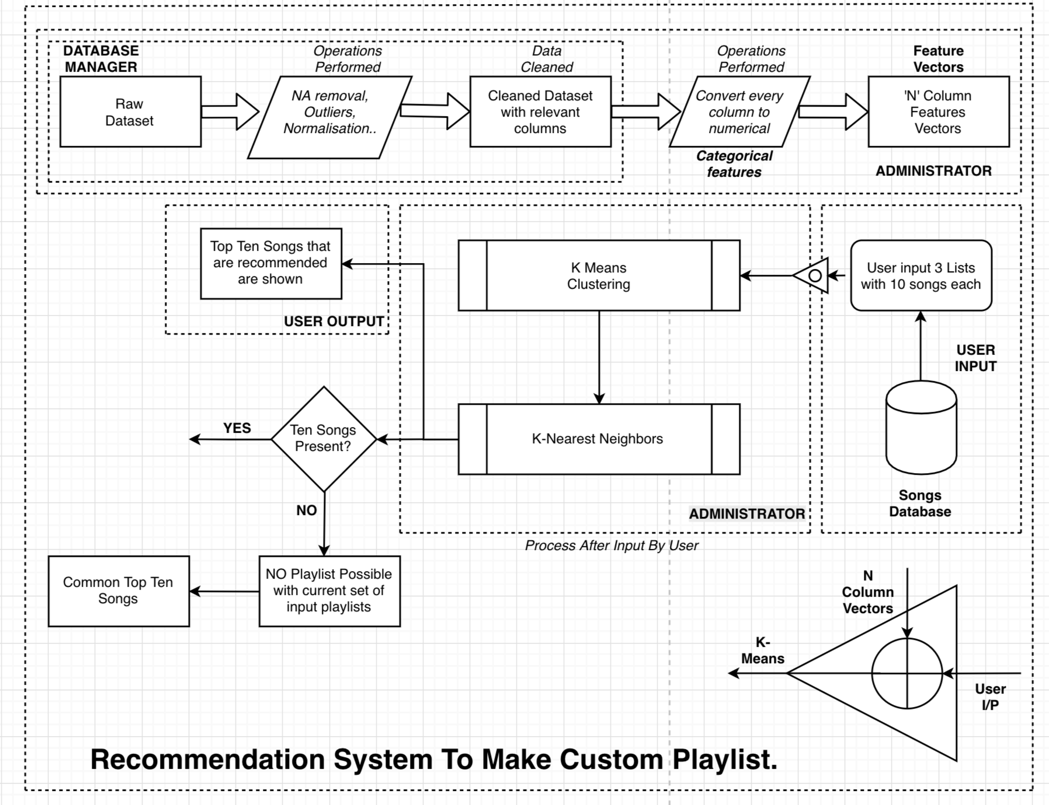
FLOW DIAGRAM

Slide 11
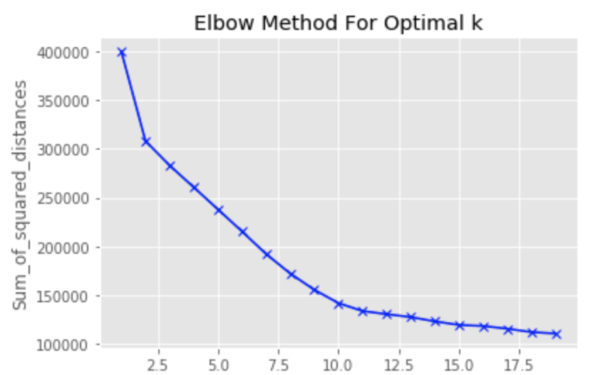
Sample Findings
One important part was to find the optimal value of “K” of K-Means clustering, Elbow test was used to find the K
In this case, we observe that the optimal value for “K”=10

Slide 12

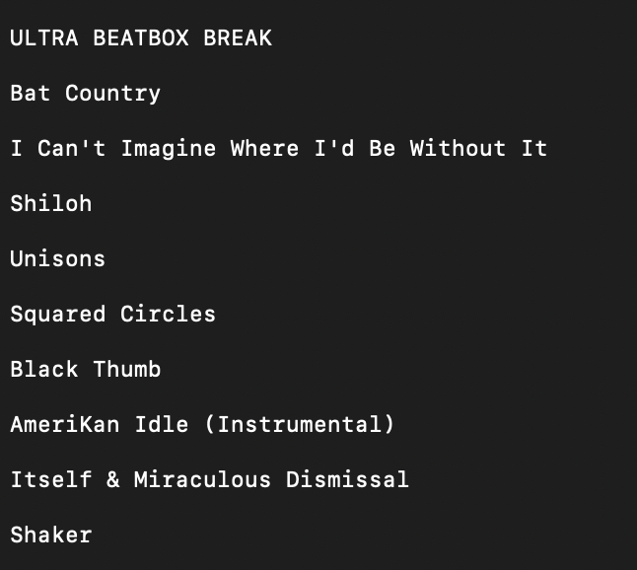
Output
The output of our application is clear and concise
It is a list of 10 songs which are recommended to the user by our system

Slide 13
Future Extensions
Trying new algorithms to see if runtime of the application can be reduced
Use Association rules to generate even better recommendation system
Try to add more features along with the present ones to improve accuracy

Slide 14
References and Resources
Programming Language : Python
User Interface : Flask Web Framework
Libraries : numpy , pandas , matplotlib , json
Flask: http://flask.pocoo.org/
K-means: https://www.datascience.com/blog/k-means-clustering

Slide 15
Acknowledgements
We would like to thank Prof. Antonio Miranda , Harsha S Tirumala and everyone else involved in this project

